Slide 1
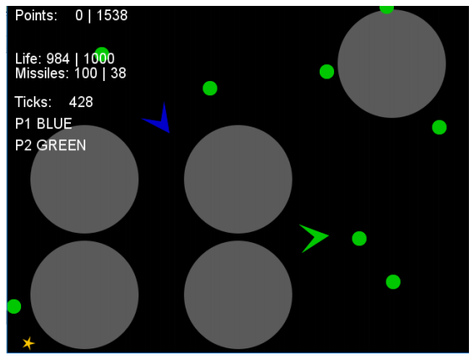
Game Design Spaces and Sample-Efficient Noisy Optimisation IGGI Games Design II
Simon Lucas, Diego Perez
and Jialin Liu

Slide 2
To Do
Update the NT-BEA Slides – May even separate this deck into two parts – one looking at the design spaces, and the other looking at the sample-efficient algorithms
Also mention MarioGAN work somewhere…

Slide 3
Aims
Previously we looked at aspects of a game that could be varied
And how aspects of game-play could be measured
We’ll revisit some of that
And consider practical ways in which we can analyse game-play data in order to improve a game
Recognise that ‘improve’ is subjective
How can we make it objective?

Slide 4
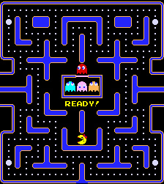
What to tune?
Which aspects of Ms Pac-Man could be easily tuned?
i.e. parameters that could be identified or easily invented and varied

Slide 5
Game Tuning
We made a change:
Can the difference be detected? How?
Hole detection / exploits?
Entropy changes?
More drama? (e.g. more flux in obvious measures?)
Can we learn a new strategy?
Make better bots?
Can GUI frustration be measured?
Analysed touch events, near misses?
Bot Id Detection?

Slide 6
Objective measures of game-play (and automating the measurements)
The automatic part comes from having AI-bots play through a game
What we measure will depend on the bots
Different bots may give rise to VERY different measurements
If we can use General AI (e.g. GVGAI) bots, then we have a ready supply of play testers

Slide 7
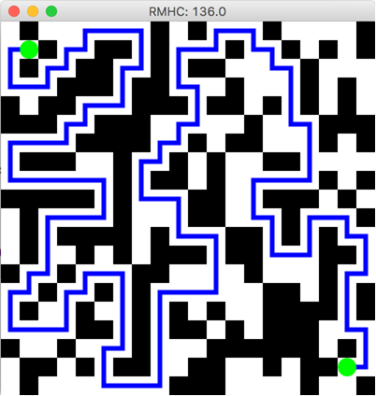
Can also use other measures of a game – don’t always need bots
This maze was evolved
Random Mutation Hill Climber (RMHC) and (1+1) ES
Representation:
Bit vector of length 400 (20 x 20)
Fitness measure: longest shortest path between the two green dots

Slide 8
Examples from the literature
We’ve already seen Flappy Bird example (Isaksen)
Consider also:
Frayn (Monopoly) – just an analysis
Togelius et al (Car racing)
Togelius et al (Mario)
Powley et al (

Slide 9
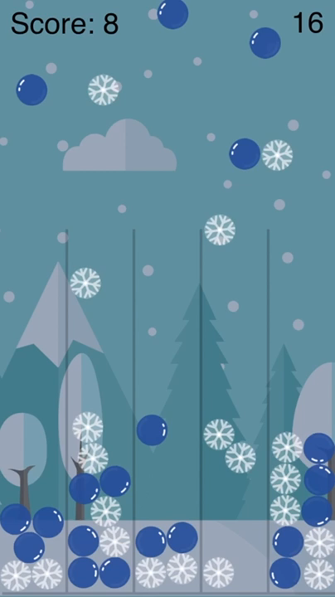
Let it Snow

Slide 10
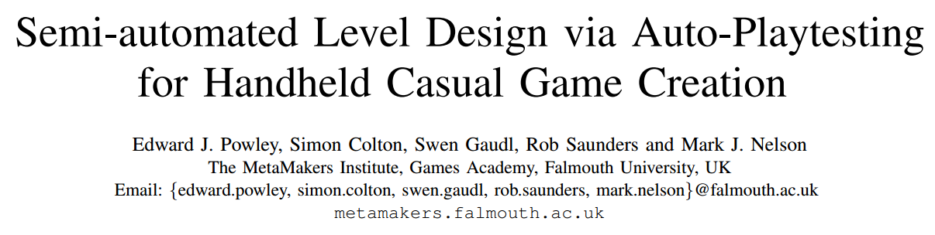
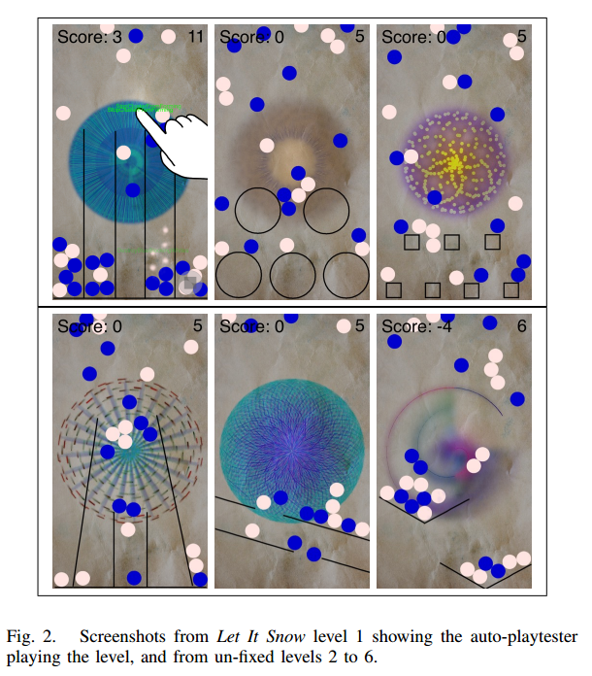
Used auto-play testing to provide feedback for game designer

Slide 11
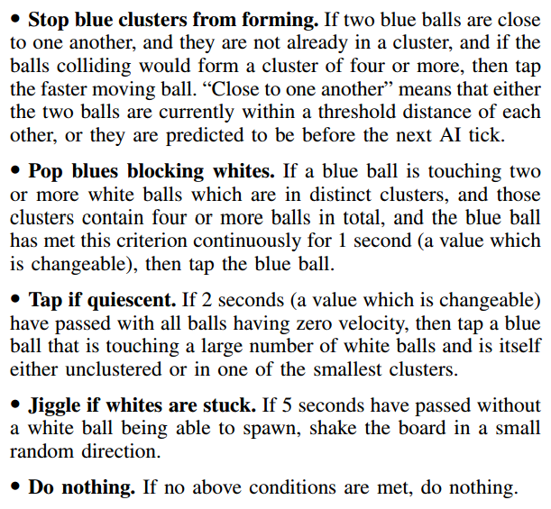
Used a Heuristic AI
Rules fire in priority order
Designer given quick feedback

Slide 12
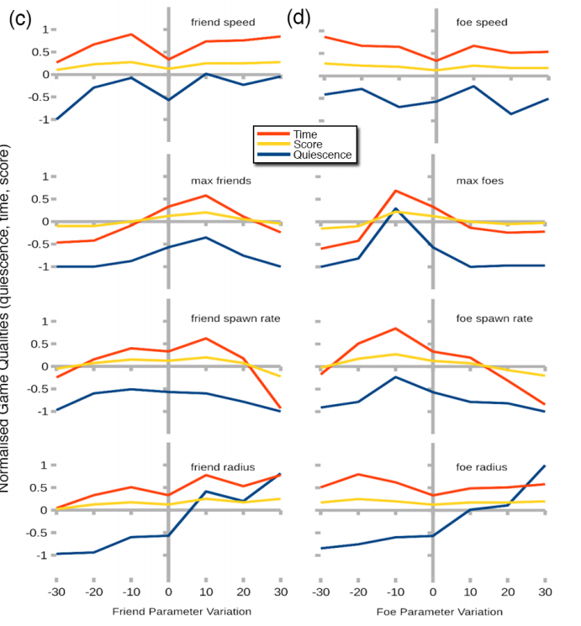
Designer can watch game play and study graphs
Effects of varying parameters can be observed
Compared with designer’s ideal values

Slide 13
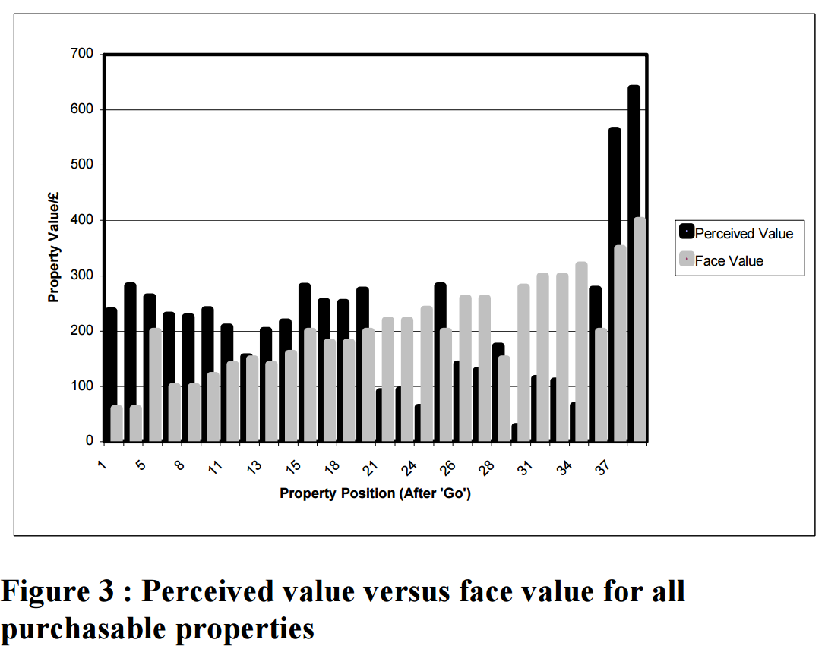
Monopoly (Frayn, IEEE CIG 2006)
Used evolved bots to model players
And estimate true value of properties
Very different to results of a simple Markov chain analysis

Slide 14
Discussion Question
In a game such as Monopoly, should the face value differ from the real value?

Slide 15
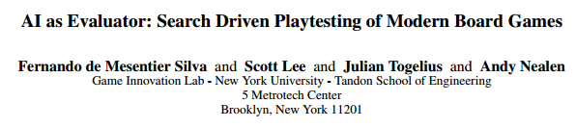
Uses hand-coded AI bots to play-test aspects of Ticket to Ride

Slide 16
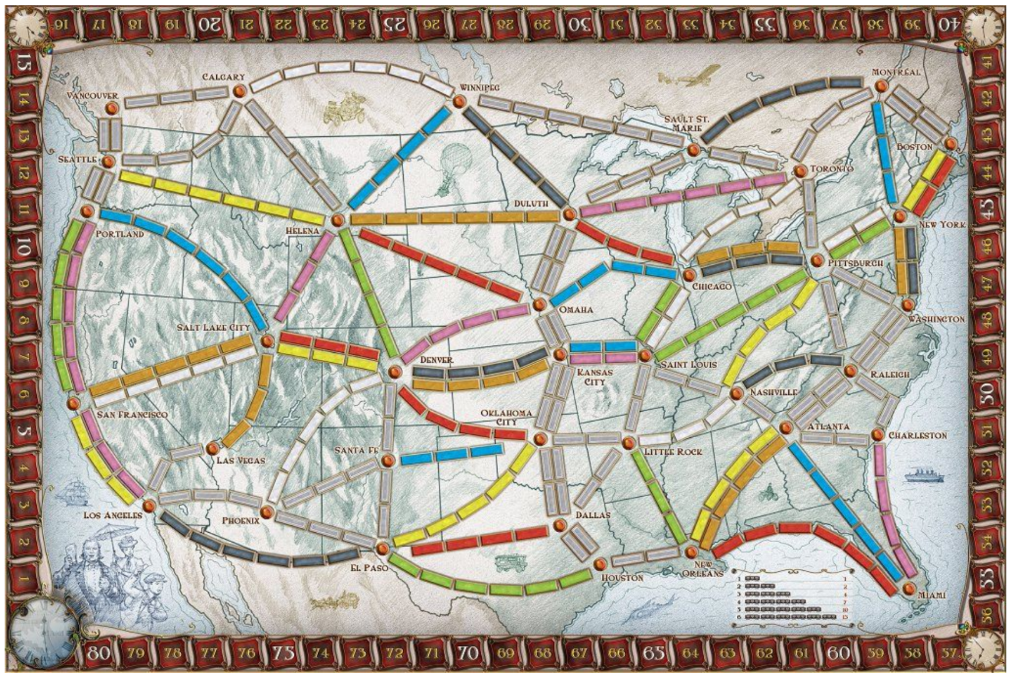
Analysing Ticket to Ride with Bots

Slide 17
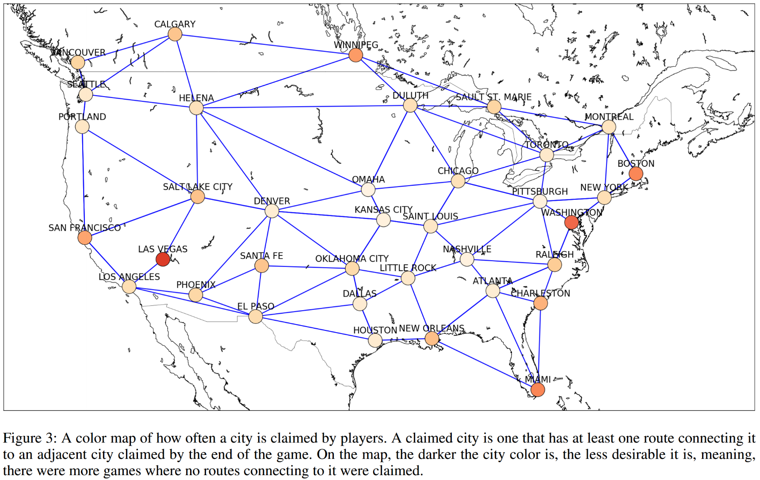
City Heat Map

Slide 18
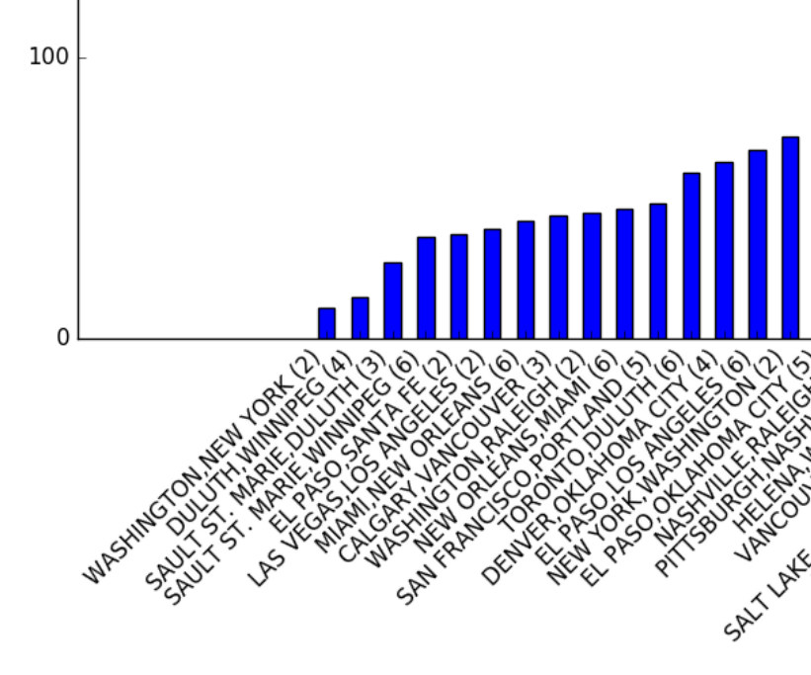
Routes ownership rate by winner

Slide 19
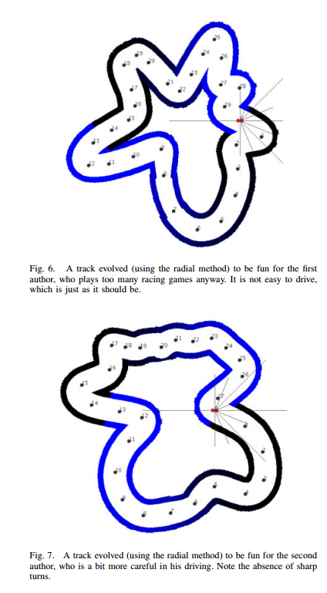
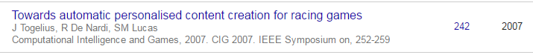
Imitation Learning for Track Tuning Togelius, De Nardi and Lucas, IEEE CIG 2007
Player data was captured from players
Imitation learning to train bots to drive like players
Bots then used to play test tracks
To provide required level of difficulty for each player type (e.g. Julian, top, Renzo, bottom)

Slide 20
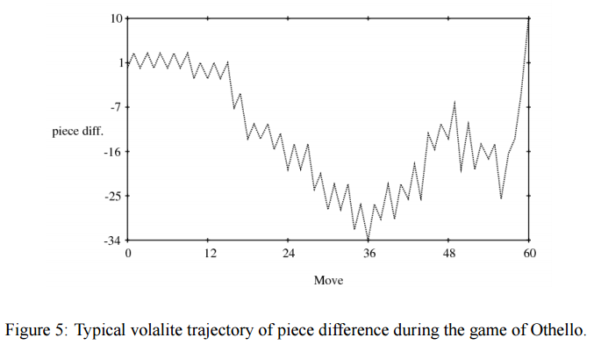
Evolving for Drama
Tuning for dramatic outcomes
Othello: good example of game with drama

Slide 21
Games can be parameterised
Player performance can be measured
Games can be tuned
How best to do this?

Slide 22
Game Tuning and Noisy Optimisation
Tuning games with AI bots is relatively expensive
These short games may take 1 second or more to run
Even when running MUCH faster than real time

Slide 23
Game Design: Also Noisy!
Can design a game
But each time an AI agent or human player plays:
The experience will be different
To to the game, or the player actions
In a population of players each one may play differently
And therefore have a different experience
We can measure aspects of this experience
And view game design as noisy optimisation

Slide 24
Value of Fitness Landscape Modelling
Can lead to more efficient search
Fitter solutions are found more quickly
We learn more about the problem
Aim now is not just to find fittest possible solutions
But also estimate value of untested points in the search space

Slide 25
System Diagram
Note the fat connection between the EA and the landscape model
Bandit Fitness Landscape Model
Noisy Fitness Evaluator
Bandit EA

Slide 26
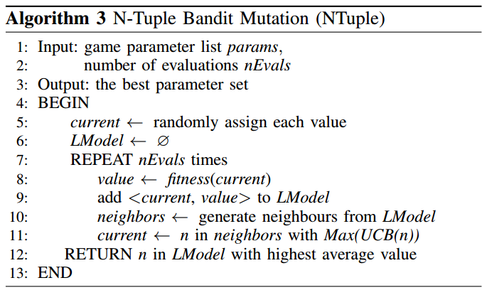
Bandit Landscape Algorithm
Each evaluation is noisy

Slide 27
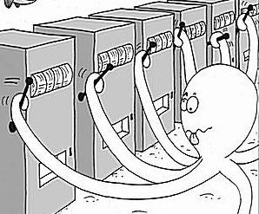
The Multi-Armed Bandit Problem
At each step pull one arm
Noisy/random reward signal
In order to:
* Find the best arm
* Minimise regret
* Maximise expected return
Notes:
Show first part of Excel simulation

Slide 28
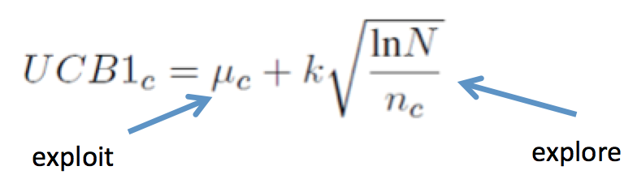
Which Arm to Pull? Recall UCB1 Balances Exploration v. Exploitation
UCB1 (Auer et al, 2002)
Choose arm j so as to maximise:
Upper bound on variance (explore)
Mean so far (exploit)
Notes:
Show Flat MC, epsilon-greedy and UCB1 part of Excel demo

Slide 29
The New Game In Town: Search Space Design!
Choose parameters and possible values
These may be of any type, but we encode them as a number of discrete choices
Tips:
Choose interesting parameters to vary, given your insight into the game
And a suitably varied set of choices for each parameter
Each point in the space will be encoded as a vector (array) of integers

Slide 30
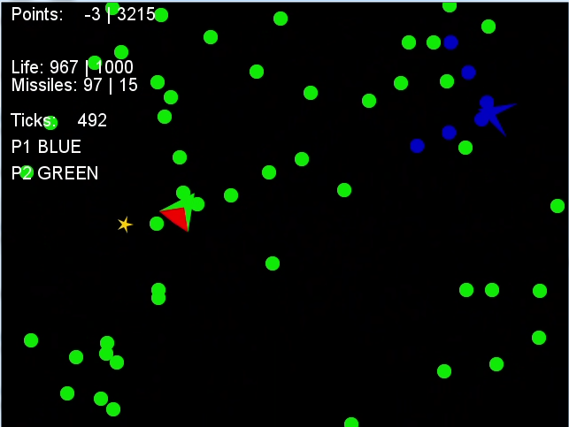
Example Game: Space Battle (Thanks to Mike and Raluca)

Slide 31
Example: Simple Space Battle
public enum BattleParamNames { DAMAGE_RADIUS, DAMAGE_COST, LOSS, SHIP_SIZE, ROTATION, THRUST } …
EvoVectorSet params = new EvoVectorSet();
params.params.add(new EvoDoubleSet(
DAMAGE_RADIUS.toString(), new double[]{5, 20, 50, 100, 200})); params.params.add(new EvoDoubleSet(
DAMAGE_COST.toString(), new double[]{1, 5, 20, 50}));
…

Slide 32
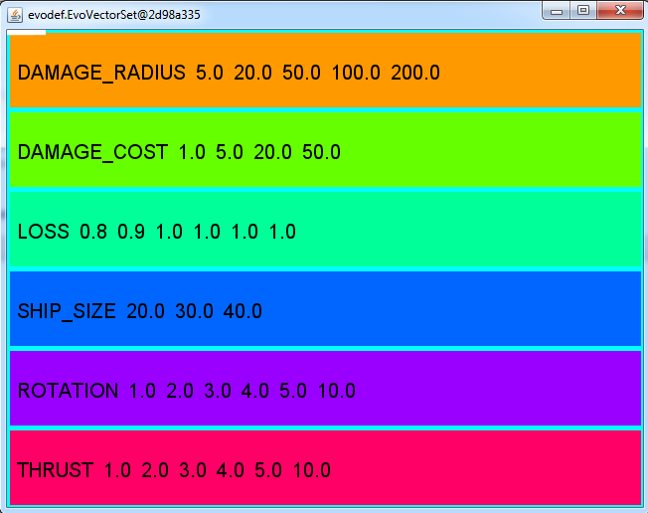
Sample Search Space How many points are in the space?

Slide 33
Answer: 12,960
In terms of typical EA search spaces this is tiny
So what makes it hard?
Each evaluation is expensive
Each evaluation is noisy

Slide 34
Expense of Agent-Based Game Evaluation
If a game is noisy, may need R repetitions to play it to gain a true picture of how it plays
Suppose each game lasts for T game ticks
In GVGAI, each tick is allowed 40ms i.e. 25 frames per second.
So the evaluation of a game for each agent (or each distinct pair of agents) takes:
(R * T) / 25
Typical vales: R = 5, T = 500, could need 100s per fitness evaluation
Can we do better?

Slide 35
Solutions
Use more efficient search algorithms that do clever resampling
Reduce the size of the search space
As a designer really think about which parameters you wish to vary
Use faster games – may achieve > 1m ticks per second
Be patient (I’m not good at this)

Slide 36
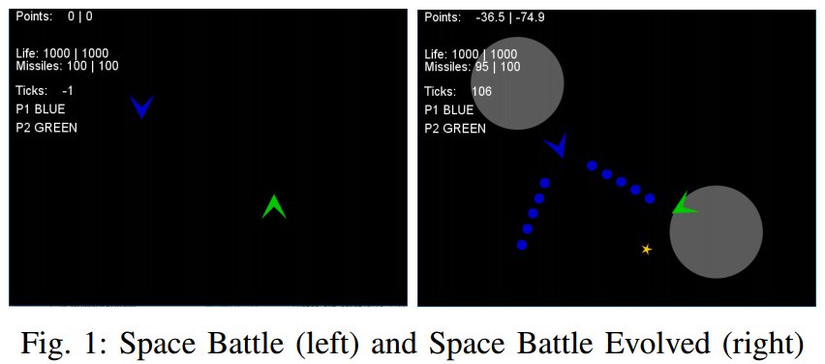
Evolving Space Battle Variants
You’ve already played with this a bit

Slide 37
Fitness Landscape Model Interface
public interface FitnessLandscapeModel {
void addPoint(int[] p, double value); // return a Double object - a null return indicates that // we know nothing yet; Double getSimple(int[] x);
// careful - this can be slow –
// it iterates over all points in the search space!
int[] getBestSolution(); int[] getBestOfSampled(); int[] getBestOfSampledPlusNeighbours(int nNeighbours); }

Slide 38
The Bandit Landscape EA
int[] p = SearchSpaceUtil.randomPoint(searchSpace); while (evaluator.nEvals() < nEvals) { double fitness = evaluator.evaluate(p); banditLandscape.addPoint(p, fitness); EvaluateChoices evc =
new EvaluateChoices(banditLandscape, kExplore); while (evc.n() < nNeighbours) { int[] pp = mutator.randMut(p); evc.add(pp); } p = evc.picker.getBest(); } int[] solution = banditLandscape.getBest(); return solution;

Slide 39
Noisy Sample Problem Noisy Win Rate Optimisation
Optimise a bit string such that
Each fitness evaluation flips a biased coin
P(win) = Math.rand < (x / (2^n-1))
i.e. win prob is given by:
binary number value of bit string / max possible
This very roughly models this situation game parameter optimisation where some parameters are much more sensitive than others

Slide 40
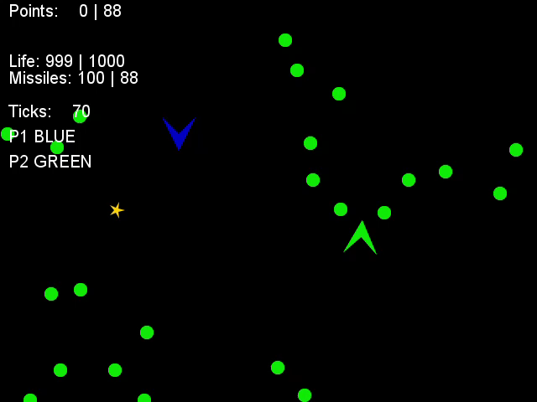
Unfit

Slide 41
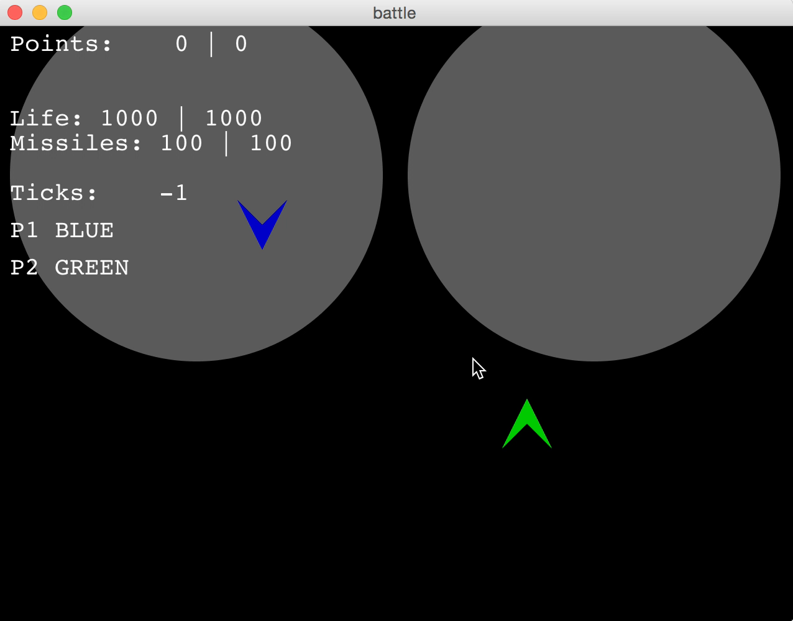
A bit fitter

Slide 42
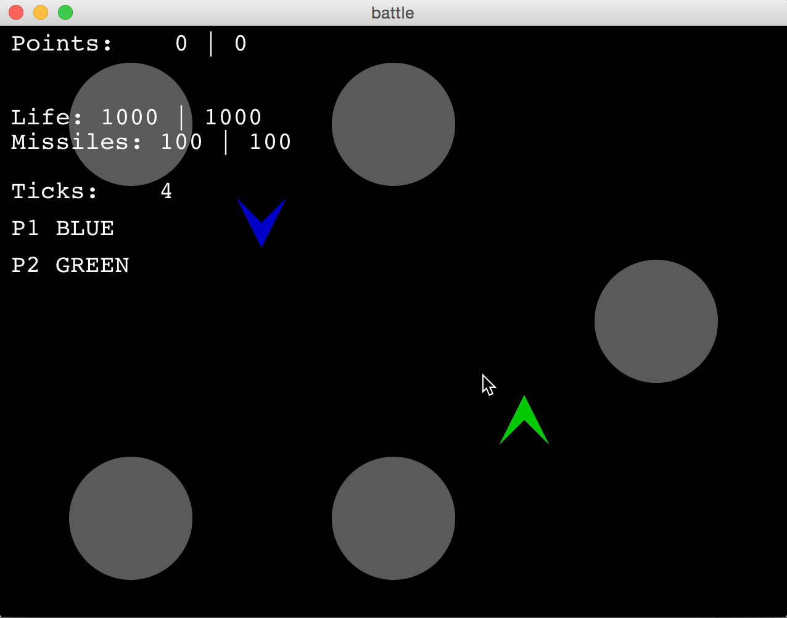
A bit fitter

Slide 43
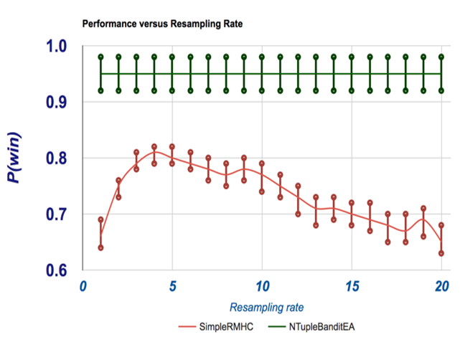
Budget: 100 Fitness Evals

Slide 44
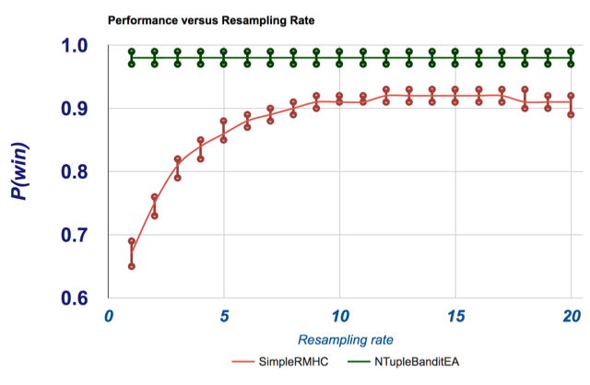
Budget: 500 Fitness Evals

Slide 45
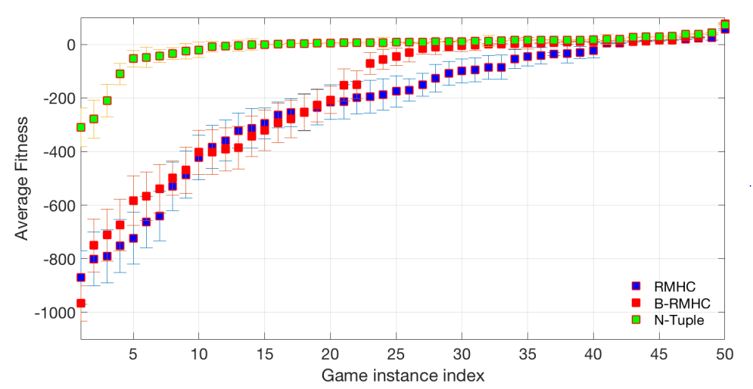
What this means for Space Battle This plot shows true fitness of individual return for each of 50 runs

Slide 46
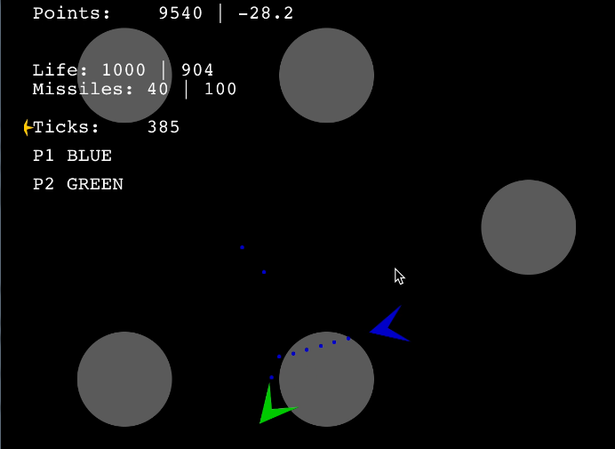
A fitter version of Space Battle? (evolved by Mike and Raluca using NTupleBanditEA)

Slide 47
Lab Exercise
For the game of your choice, pick a set of parameters to tune
Define an objective to optimise
Write code to choose random points in the search space to test (get an idea of fitness distribution)
Tune the parameters manually
Over a similar time period, tune them automatically using the RMHCTest code (see exercise 1.3)
http://orb.essex.ac.uk/ce/ce810/gd2/2017/labs/AgentsLabScript.pdf

Slide 48
Summary
Games have parameters
They can and should be tuned
Do this manually using your own insight
And also try to do it automatically
Using available or invented metrics
And play-testing by AI bots

